Slide 1
INPUT DESIGN AND PROTOTYPING
Notes:
Chapter 16 – Input Design and Prototyping

Slide 2
Data Capture and Data Entry
Data capture – the identification and acquisition of new data (at its source).
  Source documents – forms used to record business transactions in terms of data that describe those transactions.
Data entry – the process of translating the source data or document (above) into a computer readable format.
Notes:
Chapter 16 – Input Design and Prototyping
No additional notes.

Slide 3
Data Processing
Data processing is all processing that occurs on the data after it is input from a machine readable form.
  In batch processing, the entered data is collected into files called batches and processed as a complete batch.
  In on-line processing, the captured data is processed immediately
  In remote batch processing, data is entered and edited on-line, but collected into batches for subsequent processing.
Notes:
Chapter 16 – Input Design and Prototyping
No additional notes.

Slide 4
Input Design Guidelines
Capture only variable data.
  Not data that can be looked up.
Do not capture data that can be calculated or stored in computer programs as constants.
  Extended Price, Federal Withholding, etc.
Use codes for appropriate attributes.
Notes:
Chapter 16 – Input Design and Prototyping
No additional notes.

Slide 5
Source Document / Form Design Guidelines
Include instructions for completing the form.
Minimize the amount of handwriting.
Data to be entered (keyed) should be sequenced top-to-bottom and left-to-right.
When possible use designs based on known metaphors.
Notes:
Chapter 16 – Input Design and Prototyping
No additional notes.

Slide 6
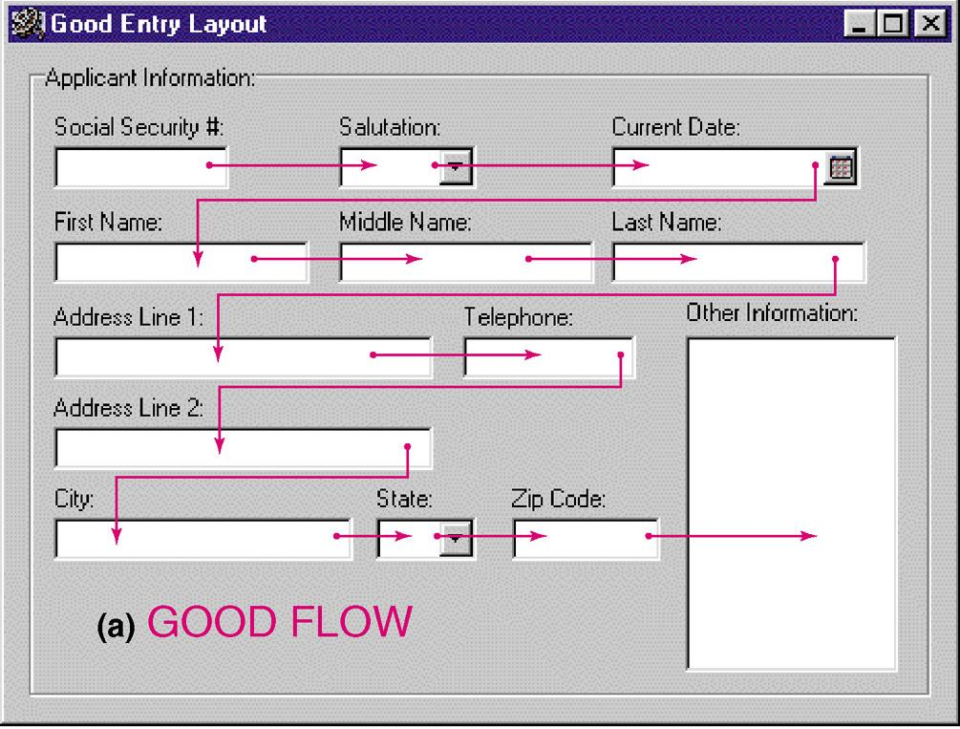
Good Flow in a Form
Notes:
Chapter 16 – Input Design and Prototyping
No additional notes.

Slide 7
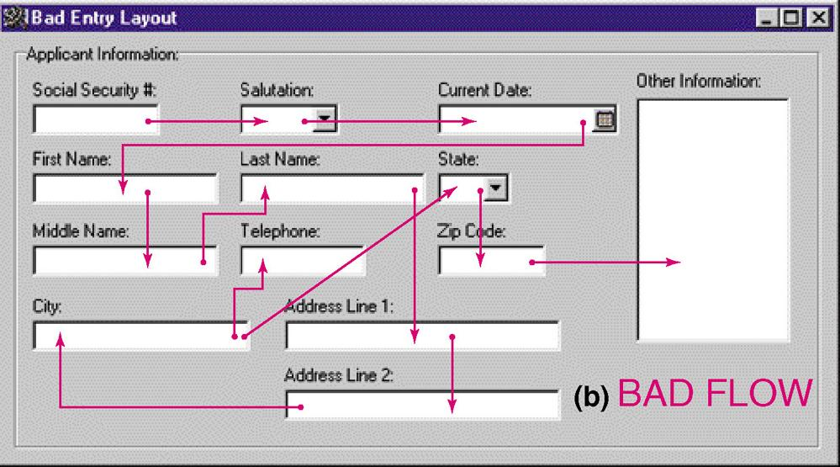
BAD Flow in a Form
Notes:
Chapter 16 – Input Design and Prototyping
No additional notes.

Slide 8
Internal Controls for Inputs
The number of inputs should be (to minimize risk of lost transactions).
  For batch processing
    Use batch control slips
    Use one-for-one checks against post-processing detail reports
  For on-line systems
    Log each transaction as it occurs to a separate audit file
Validate all data
  Existence checks
  Data-type checks
  Domain checks
  Combination checks
  Self-checking digits
  Format checks
Notes:
Chapter 16 – Input Design and Prototyping
No additional notes.

Slide 9
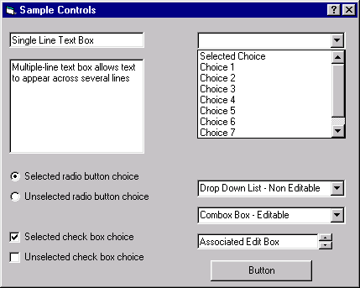
Common GUI Controls (Windows and Web)
Text boxes
Radio buttons
Check boxes
List boxes
Drop down lists
Combination boxes
Spin boxes
Buttons
Notes:
Chapter 16 – Input Design and Prototyping
No additional notes:

Slide 10
Common GUI Controls Uses
Text boxes
  When the input data values are unlimited in scope
Radio buttons
  When data has limited predefined set of mutually exclusive values
Check boxes
  When value set consists of a simple yes or no value
List boxes
  When data has a large number of possible values
Drop down lists
  When data has large number of possible values and screen space is too limited for a list box
Combination boxes
  When need to provide the user with option of selecting a value from a list or typing a value that may or may not appear in the list
Spin boxes
  When need to navigate through a small set of choices or directly typing a data value
Notes:
Chapter 16 – Input Design and Prototyping

Slide 11
Input Design Process
Identify system inputs and review logical requirements.
Select appropriate GUI controls.
Design, validate and test inputs using some combination of:
  Layout tools (e.g., hand sketches, spacing charts, or CASE tools.
  Prototyping tools (e.g., spreadsheet, PC DBMS, 4GL)
If necessary design source documents.
Notes:
Chapter 16 – Input Design and Prototyping
No additional notes.

Slide 12
A Logical Data Structure for Input Requirements
ORDER = ORDER NUMBER
+ ORDER DATE
+ CUSTOMER NUMBER
+ CUSTOMER NAME
+ CUSTOMER SHIPPING ADDRESS = ADDRESS >
+ ( CUSTOMER BILLING ADDRESS = ADDRESS > )
+ 1 { PRODUCT NUMBER +
QUANTITY ORDERED } n
+ ( DEFAULT CREDIT CARD NUMBER )
ADDRESS = ( POST OFFICE BOX NUMBER )
+ STREET ADDRESS
+ CITY
+ STATE
+ POSTAL ZONE
Notes:
Chapter 16 – Input Design and Prototyping
Teaching Notes
It may be useful to walk through this technique for specifying “logical” output requirements.
The red and blue symbols are relational operators, that is, they specify the relationship between attributes to be included in the output in terms of
Sequence +
Selection [ data attributes]
Iteration min { data attributes } max
Optionality ( data attributes)
Many CASE tools support this logical notation.

